Slide 1
Social Network Graph Compression
Sourabh Jain(IIT2010038)
Aman Kumar(IIT2010043)
Prashant Pal(IIT2010042)
Guided by:
Prof. U.S. Tiwary

Slide 2
Outline
Background
Goals and Objective
Motivation and literature survey
Existing Approach
Framework
Some Observations
Concept
Heuristic
Result
References

Slide 3
Goals and objective
We have to given a simple unweighted directed graph and we want query-able compression of these social networks.
A simple directed graph is a directed graph such that there does not exist a self-loop, i.e., no edge (u, u) for any vertex u, and there is at most one edge from a source u to a destination v.
Social networks should be compressed in a way that they still can be queried efficiently without decompression.

Slide 4
Motivation
Graphs are everywhere as in social networks, communication networks, biological networks and World Wide Web . Now days, the size of these graphs become larger and larger. Some graphs contain millions or even billions of nodes and edges. Such a bulky graph presents new challenges to graph mining.
Compression is useful for storage as well as transmission.
In distributed environment also compression is useful for decreasing communication cost which is main factor.

Slide 5
literature survey
We have studied algorithm given by Boldi and Vigna for web graph compression and social network graph compression related research papers available on ACM KDD-Cup.

Slide 6
Existing Approach: Web Graph
Boldi & Vigna
Locality of webgraphs . A large percentage of links are intra-domain.
Sort by URL to locality of links.
Sort the links of out links of each node.
Use code to encode the gaps between out links.
This compress the web graph down to almost 3 bits per edge.

Slide 7
Observations
Optimality of adjacency matrix representation:
Consider a class of random graph on n vertices where each possible edge is included the graph with probability half.
Based on information theoretical lower bound any compression scheme use at least n2 bits.
Probably for this class of grammar adjacency matrix is optimal schema.
So, for dense graph adjacency matrix is optimal solution.

Slide 8
Observations
Optimality of adjacency list representation:
Consider a class of random graph on n vertices where
→ Each vertex has only one outgoing edge
→ Destination of that edge is picked randomly.
For this class of grammar any compression schema uses at least n(logn) bits.
For this case adjacency list is a optimal solution.
For sparse random graph adjacency list is optimal solution.

Slide 9
Idea
It is known that social networks are locally dense but globally sparse.
General idea is to use adjacency matrix for local
edges and pointer for global edges.
But problem is to determine whether an edge is global or local.

Slide 10
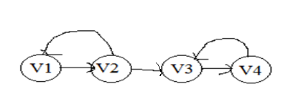
Idea
Let’s consider a very simple case.
Assume a linear arrangement of nodes.
Notice all the edges are local(i.e. all edges are connected only from it’s neighbor node.)

Slide 11
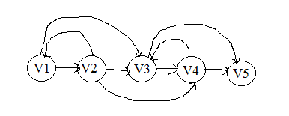
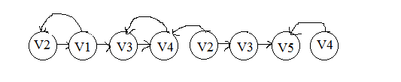
Idea
Now consider more associated case.
No arrangement of vertices so that every edge is local.
A vertex has to appear more than once for such arrangement.

Slide 12
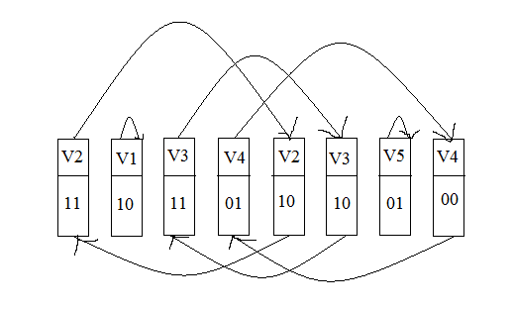
Representation
Representation schema is array in which each cell consist two bits and one pointer.
Pointer point the next appearance of same vertex.
Last appearance of vertex point to first appearance.
Idea is extend it up to 2*k bits.
Previous graph can be represented as

Slide 13
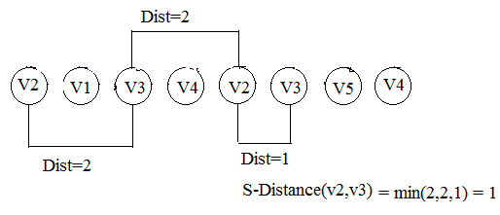
S - Distance
S – distance between any two vertices is minimum distance in 1 norm form among all the distances between than vertices .

Slide 14


MPk Linearization
An MPk linearization of a graph G is a sequence S of vertices of the graph with possible replication, such that S covers G and for all
(u, v) ∈ E(G), S-dist(u, v) ≤ k.
The length of an MPk linearization is equal to length of S.
MP1 Linearization
MP2 Linearization

Slide 15
MPk Linearization
Given an MPk linearization L of G .
No. of bits use to encode G is
(2k+|log(L)|)*|L|
L = length of linearization

Slide 16
Greedy Algorithm for MPk Linearization
To Determine an optimal Mpk linearization is an NP- hard problem so we propose a greedy Method for this.
A greedy heuristic to compute MPk linearization:
→ Start with a random node and add it to list.
→ Find the node that has the most number of edges to and from the last k nodes in the list.
→ Add the node to the list and update local info.
→ Remove the edges between this node and the last k nodes in the list.
→ Repeat until no edge is left.

Slide 17

Procedure
Let a graph is given and we have to determine MP2 linearization of it .
L={ } is a sequence which is Null initially.
Iter.1 choose a random node lets v2 , list have
Iter. 2 will choose v1 because it’s having 2 edges connected to v2.

Slide 18
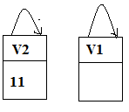

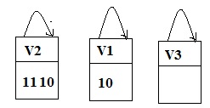

list will be
Iter. 3 remove all the traverse edges from original graph.
Iter. 4 repeat it will use last 2 entries(MP2 lin.) of sequence so choose v3 having 2 edges list will be
Iter. 5 remove edges in original graph

Slide 19
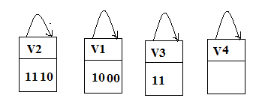

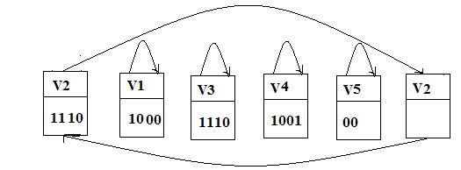
Iter. 6 it will choose v4 having 2 edges from last 2 nodes in sequence.
Iter 7 remove edges from original graph
We repeat these steps until total edges in original graph is 0.
At last we get sequence

Slide 20
Heuristic
The graph gets sparser and sparser while we are removing the edges.
We use a threshold to reduce the value of k in the process of linearization.
Value of k is reduced by Redundancy factor(RT).
We use Density Threshold (DT) to reduce value of k .
We watch the average local density for the recent positions in the list and when it is decreases by DT we reduce value of k.

Slide 21
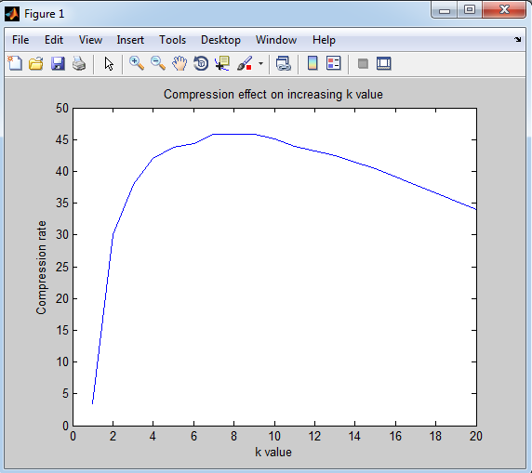
Result
We use a peter-hamster dataset for testing our algorithm for different k values.
That graph was having around 22,900 edges with 2400 vertices.
For different k values we obtain different compression ratios.
Compression ration is around 46.8 at k=8 .

Slide 22
Conclusion
Our method can efficiently answer more types of query and retain the comparable compression rate than the state-of-the-art methods.
Our framework reduces the problem compressing a graph to an intuitive combinatorial problem

Slide 23
Future work
Finding smarter algorithms for linearizing a graph.
Using other compression techniques on top of our framework.
Hardness result for MPk linearization when k is fixed.

Slide 24
Thank You

